Slide 1
Software Engineering Introduction
CSCI 5828: Foundations of Software Engineering
Lecture 10

Slide 2
Testing revisited
Testing the system or System Under Test (SUT)
Unit - Tests that cover low-level aspects of a system
Integration - Tests that check that modules work together in combination
Acceptance - Tests performed by the user or product owner
Acceptance
Integration
Unit

Slide 3
Simple Aged Cache Revisited (Example)

Slide 4
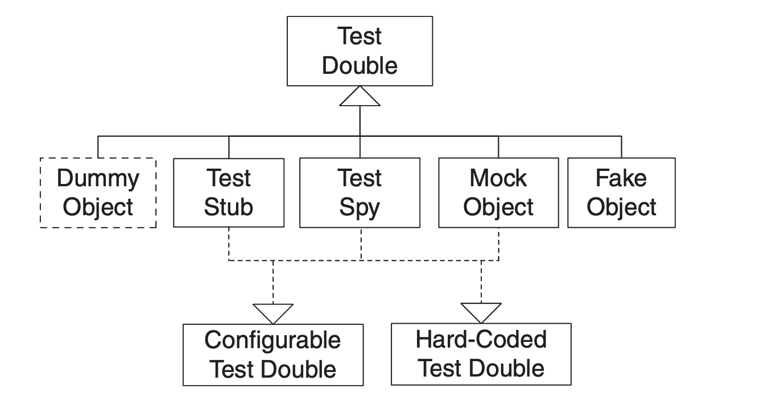
Test Doubles
From - xUnit Test Patterns: Refactoring Test Code 1st Edition
by Gerard Meszaros ISBN-13: 978-0131495050

Slide 5
Test Doubles
Stubs canned answers to calls made
Spy mocks or stubs that record; implement the 2 or 3 methods of interest
Mocks pre-programmed with expectations
Fake working implementations with shortcuts
Dummy - never actually used

Slide 6

Inversion of Control (IoC)
Goal to increase modularity
also called the Hollywood Principle
Don't call us, we'll call you
The Mesa Programming Environment http://www.laputan.org/drc/drc.html
Designing Reusable Classes http://www.digibarn.com/friends/curbow/star/XDEPaper.pdf

Slide 7
Dependency Injection
Type of IoC
Common types of Dependency Injection
Constructor injection
Setter injection

Slide 8
SOLID Design Principles
Single Responsibility Principle Open/Closed Principle Liskov Substitution Principle Interface Segregation Principle Dependency Inversion Principle

Slide 9

Mockito (Example)

Slide 10
Test Driven Development (TDD)
Red - write a failing test Green - get the test passing Refactor - improve the codebase

Slide 11
Behavior Driven Design (BDD)
Specification: Stack
When a new stack is created Then it is empty
When an element is added to the stack Then that element is at the top of the stack
When a stack has N elements And element E is on top of the stack Then a pop operation returns E And the new size of the stack is N-1
Ubiquitous language Developers and business analysts Outside-in testing

Slide 12
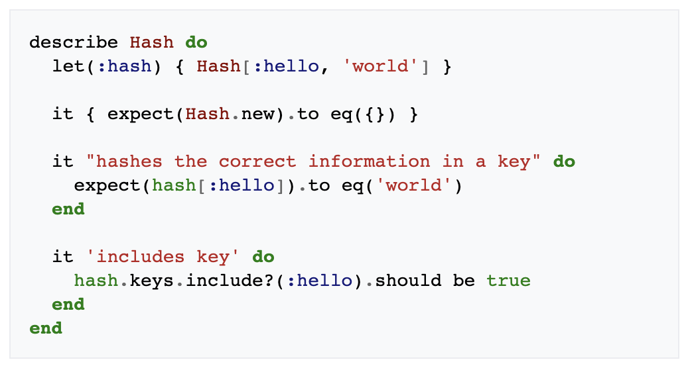
Behavior Driven Design (BDD)

Slide 13
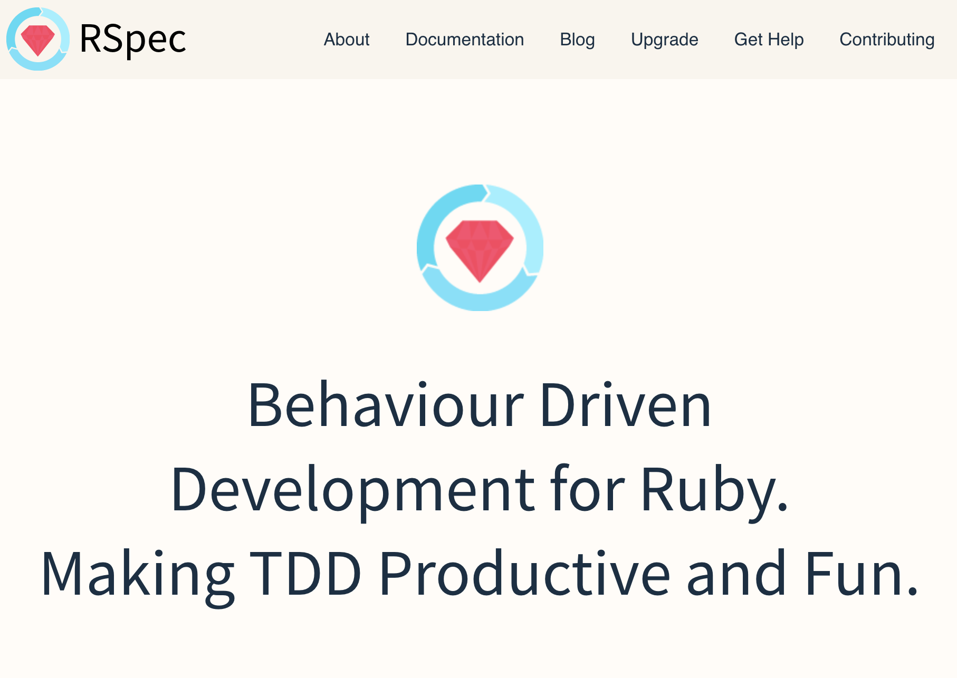
RSpec (Example)

